Slide 1


Minor Project - I
Password
Diary
Presented by Team E-10 :
Krishnakanta Naik ( 19CSE285 )
Kumar Adarsh ( 19CSE286 )
Pramod Kumar Butha ( 19CSE341 )
Under the supervision of :
Mr. SN Das
BTech Co-Ordinator

Slide 2
Table of Contents
AIM of the project
Code Explanation
Points for discussion
Practical Demonstration
Limitation
Conclusion

Slide 3
AIM of the Project
The AIM of the project is to provide and guide the internet users for creating strong passwords for their different online accounts and keep them safe in online platforms from hackers or from any kind of unauthorized access by the intruders.
Our project suggests, manages and stores the passwords in an encrypted form for the users which they can use in there online accounts.

Slide 4

Code Explaination
Points for discussion
Code Editor
Technology Used
Hierarchy of Folders
Front-End Explained
Password Strength Estimator
Back-End Explained
Encryption Algorithm

Slide 5

Code Editor
VISUAL STUDIO CODE
We have used VS Code for the developement of the project as it is a open source, powerful and easy to use IDE.

Slide 6



Technologies Used
DATABASE
FRONT-END
BACK-END
For Database, MySQL workbench is used which contains four columns id, password, title, and iv. Where the id column contains a serial number for every new password, the password column contains the encrypted passwords, the title column contains every account name where the password is used and the iv column contains the encrypted numbers which act as an identifier to the encrypted passwords and also used for the decryption process also.
The front-end development of the project is done with React JS in which we ensure to provide a user-friendly UI (User Interface) with a responsive layout suitable for any screen size device with some different sections containing the introduction and how to use Password Tester effectively for their different accounts.
The backend of the project is developed with Node JS which handles the cryptography part, where it converts the user entered plain text passwords into an encrypted form using the AES-256-CTR algorithm which is imported from the "crypto" module present in Node JS and whenever the user wants to get the password back it will be decrypted and returned back.

Slide 7
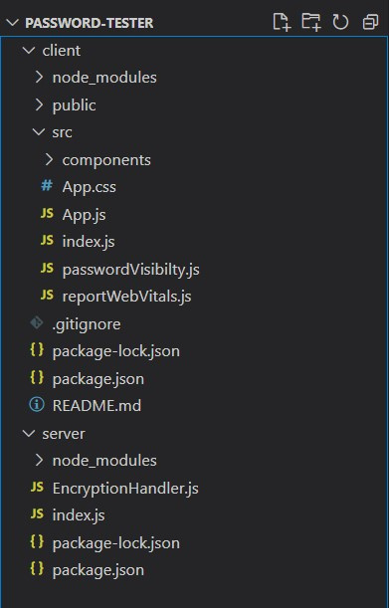
Folders
Hierarchy
Explained
Points for discussion
This is the hierarchy system of the folder where Reacts JS is installed in the client folder and Node JS is installed in the server folder.

Slide 8

Front-End Explained
STRUCTURE
STYLING
React is a free and open-source front-end JavaScript library for building user interfaces or UI components. React can be used as a base in the development of single-page or mobile applications.
In the front-End, React JS provides the basic structure or skeleton to the project like the input fields, through which the user provides the password and account name or details and this details are then passed over to the Back-End using the React useState and useEffect concepts.
Bootstrap is a free and open-source CSS framework. It contains CSS- and JavaScript-based design templates for typography, forms, buttons, navigation, and other interface components.
The structure is being designed by Bootstrap 5 to give it a advanced look although we have kept the overall design decent and non-fancy type.

Slide 9
zxcvbn Password Strength Estimator
ZXCVBN PASSWORD STRENGTH ESTIMATOR TOOL
zxcvbn is a password strength estimator inspired by password crackers. Through pattern matching and conservative estimation, it recognizes and weighs 30k common passwords, common names and surnames according to US census data, popular English words from Wikipedia and US television and movies, and other common patterns like dates, repeats (aaa), sequences (abcd), keyboard patterns (qwertyuiop), and l33t speak.
We have used zxcvbn as an algorithmic alternative to password composition policy — it is more secure, flexible, and usable when sites require a minimal complexity score in place of annoying rules like "passwords must contain three of {lower, upper, numbers, symbols}".

Slide 10
Back-End Explained
BACK-END
DATABASE
The backend of the project is developed with Node JS which handles importing of the data from the Front-End and then making necessary changes like the user entered plain text passwords are converted into an encrypted form using the AES-256-CTR algorithm which is imported from the "crypto" module present in Node JS and then passing it to database for storage.
For Database Visualization, MySQL workbench is used which contains four columns id, password, title, and iv. Where the id column contains a serial number for every new password, the password column contains the encrypted passwords, the title column contains every account name where the password is used and the iv column contains the encrypted numbers which act as an identifier to the encrypted passwords and also used for the decryption process also.

Slide 11
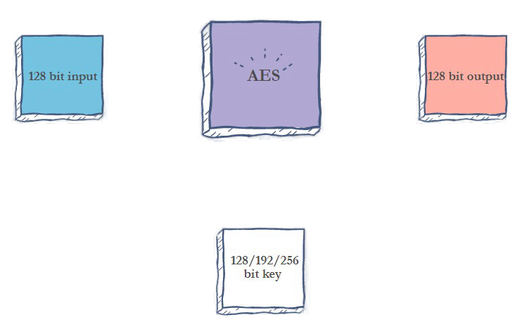



AES Encryption Algorithm
AES-256-CTR ENCRYPTION ALGORITHM
The AES algorithm (also known as the Rijndael algorithm) is a symmetrical block cipher algorithm that takes plain text in blocks of 128 bits and converts them to ciphertext using keys of 128, 192, and 256 bits. Since the AES algorithm is considered secure, it is in the worldwide standard.
The Counter (CTR) mode is a typical block cipher mode of operation using block cipher algorithm. In this version, we provide Advanced Encryption Standard (AES) processing ability, the cipherkey length for AES should be 128/192/256 bits

Slide 12

Practical Demonstration
Now, we will be going through the practical demonstration part in which we will have actual interaction with the project.

Slide 13
Limitations of the Project
UPDATE AND DELETE FACILITY
Currently our project doesn't have the option for updating or deleting previously stored passwords.
NOT HOSTED ONLINE
It is a locally hosted Web application ,there is no online connection of the web application.
NO OFFLINE STORAGE
There is no offline storage system for the passwords. In case if the DB gets hacked or erased it will be difficult to retrieve back the passwords.
NO DETECTION FOR REPETITION OF SAME PASSWORD
There is no detection for repetition of passwords so even if the user uses the same password for the new accounts it will not alert the user, which makes it a bit vulnerable.

Slide 14
CONCLUSION
A password manager is a software that will help us create a new and strong password ,and manages them. A password manager is a program that houses all your passwords, in one convenient location.

Slide 15
Thank you!

